Slide 1




NEXT GEN EMPLOYABILITY PROGRAM
Creating a future-ready workforce
Team Members
College Name
Student Name : Shrijaa.N
Student ID : 814721104051
SRM TRP ENGINEERING COLLEGE

Slide 2

CAPSTONE PROJECT SHOWCASE
Project Title
Notes Sharing Web Application using Django Framework
Abstract | Problem Statement | Project Overview | Proposed Solution | Technology Used | Modelling & Results | Conclusion

Slide 3
Abstract
The Note Sharing Web Application facilitates seamless creation, sharing, and collaboration on notes online. Through its intuitive interface accessible via web browsers, users effortlessly manage notes, categorize them, and engage in collaborative efforts. Additionally, the platform integrates features for enhanced productivity and communication, fostering efficient teamwork and knowledge sharing. Web Application is designed to provide a platform for users to create, share, and collaborate on notes online. The application offers a user-friendly interface accessible through web browsers, enabling users to easily manage their notes, organize them into categories, and share them with others. Some more other
Source :

Slide 4
Problem Statement
In today's digital age, students and professionals often struggle with disorganized and inefficient methods of sharing and managing notes. Traditional approaches, such as handwritten notes or scattered digital files, lack collaboration features, version control, and accessibility across devices. Additionally, existing note-sharing platforms may suffer from usability issues, limited functionality, or privacy concerns. Consequently, there is a pressing need for a robust and user-friendly notes sharing web application that addresses these challenges, facilitating seamless collaboration, organization, and accessibility of notes for individuals and groups across various educational and professional settings.
Fragmented Collaboration: Current note-sharing methods often result in fragmented collaboration, where individuals struggle to synchronize updates, provide feedback, and collaborate effectively in real-time. This fragmentation hinders productivity and teamwork, especially in group projects or study sessions where seamless collaboration is essential.
Version Control Challenges: With multiple users accessing and editing notes simultaneously, version control becomes a significant issue. Without proper version tracking mechanisms, users risk losing or overwriting important changes, leading to confusion, errors, and potential loss of valuable information.
Source :

Slide 5
Project Overview
Introduction : Brief description of the project and its purpose.Mention the target audience (students, professionals, etc.).
Features : List of features the application will offer (e.g., create, edit, delete notes, share notes with others, search functionality, user authentication).Prioritize features based on importance and feasibility.
User Roles : Identify different user roles (e.g., regular user, administrator).Define the permissions and capabilities of each role.
Technology Stack : Outline the technologies to be used (e.g., frontend framework like React.js, backend framework like Node.js with Express, database like MongoDB).
Architecture : High-level overview of the system architecture (e.g., client-server architecture).Describing how components will interact with each other.
Database Design : Design the database schema (e.g., tables for users, notes, permissions).

Slide 6
Proposed Solution
Load Balancer : Use a load balancer like Nginx, HAProxy, or AWS Elastic Load Balancing (ELB). Configure it to listen on a public IP address and forward traffic to your nodes.
Nodes : Set up multiple nodes (servers) hosting your web application. Each node should have the same version of the application and be configured to handle incoming requests.
Database : If your application uses a database, ensure it's accessible by all nodes. Consider using a database cluster for high availability.
Configuration Management : Use a configuration management tool like Ansible, Chef, or Puppet to manage the configuration of your nodes. This helps ensure consistency across all nodes.
Monitoring and Logging : Set up monitoring and logging to track the health and performance of your nodes. Tools like Prometheus, Grafana , and ELK stack can help with this.
Scaling : Implement auto-scaling if needed to dynamically adjust the number of nodes based on traffic load.
Security: Ensure all nodes are secure by using firewalls, regular security updates, and secure communication protocols (e.g., HTTPS).

Slide 7


Technology Used
Front-end
Back-end
Source :

Slide 8
Modelling & Results
User Modeling: Understanding user personas, their needs, preferences, and behaviors is crucial. This includes identifying target users such as students, professionals, or teams, and modeling their interactions with the application.
Feature Modeling: Defining the features and functionalities of the application based on user requirements. This may include note creation, editing, sharing, collaboration tools (e.g., comments, annotations), user management, search capabilities, etc.
System Architecture: Designing the architecture of the web application, including front-end, back-end, and database components. This involves selecting appropriate technologies and frameworks based on scalability, performance, security, and other requirements.Development
Process: Implementing the application using agile methodologies or other software development frameworks. This involves iterative development, testing, and deployment cycles to ensure continuous improvement and feedback incorporation.Evaluation
Metrics: Establishing metrics to evaluate the performance, usability, and user satisfaction of the application. This may include factors such as response time, user engagement, retention rates, and feedback from user testing sessions.
Source :

Slide 9
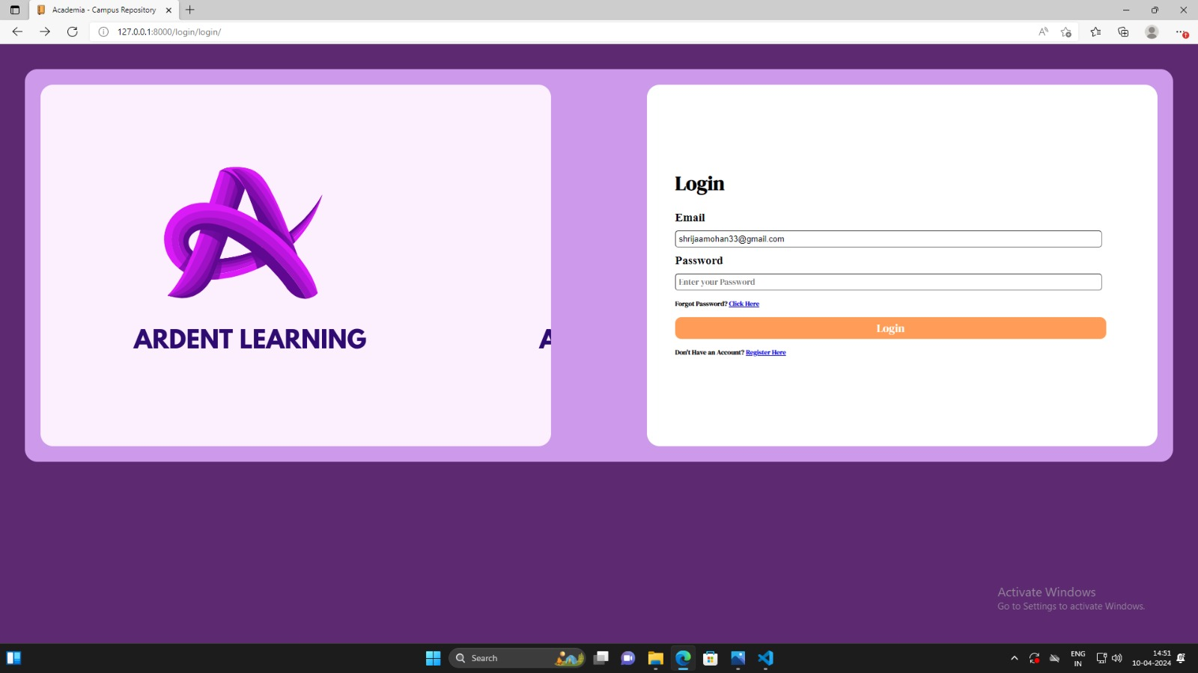
Homepage

Slide 10
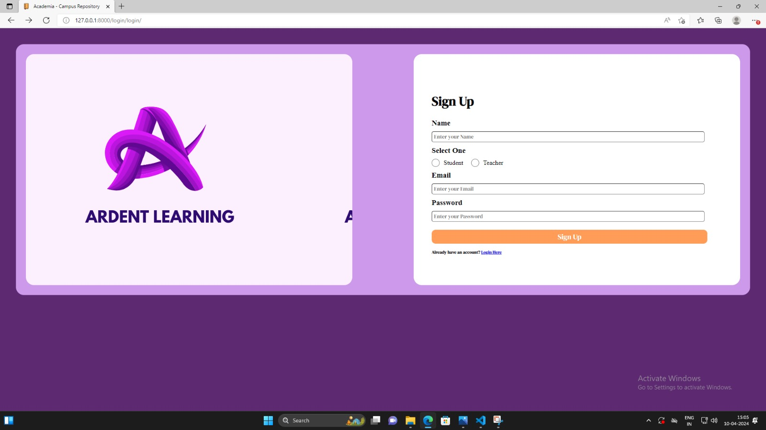
Login Page

Slide 11
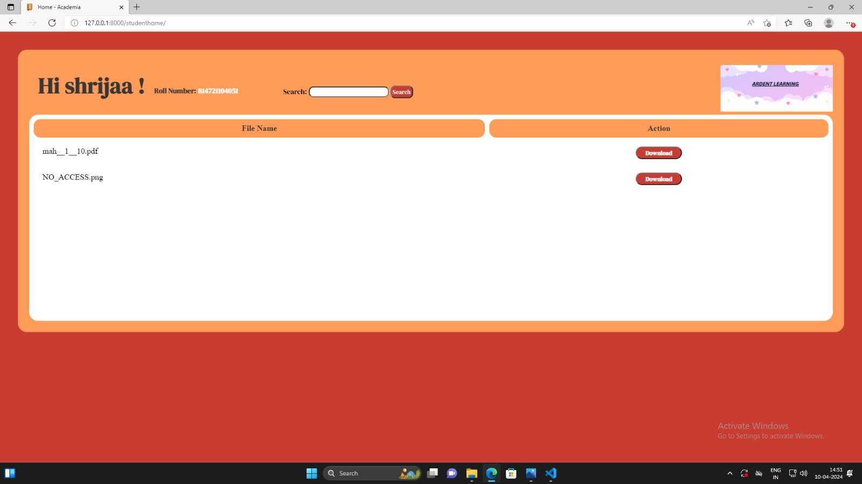
Student Login-Page

Slide 12
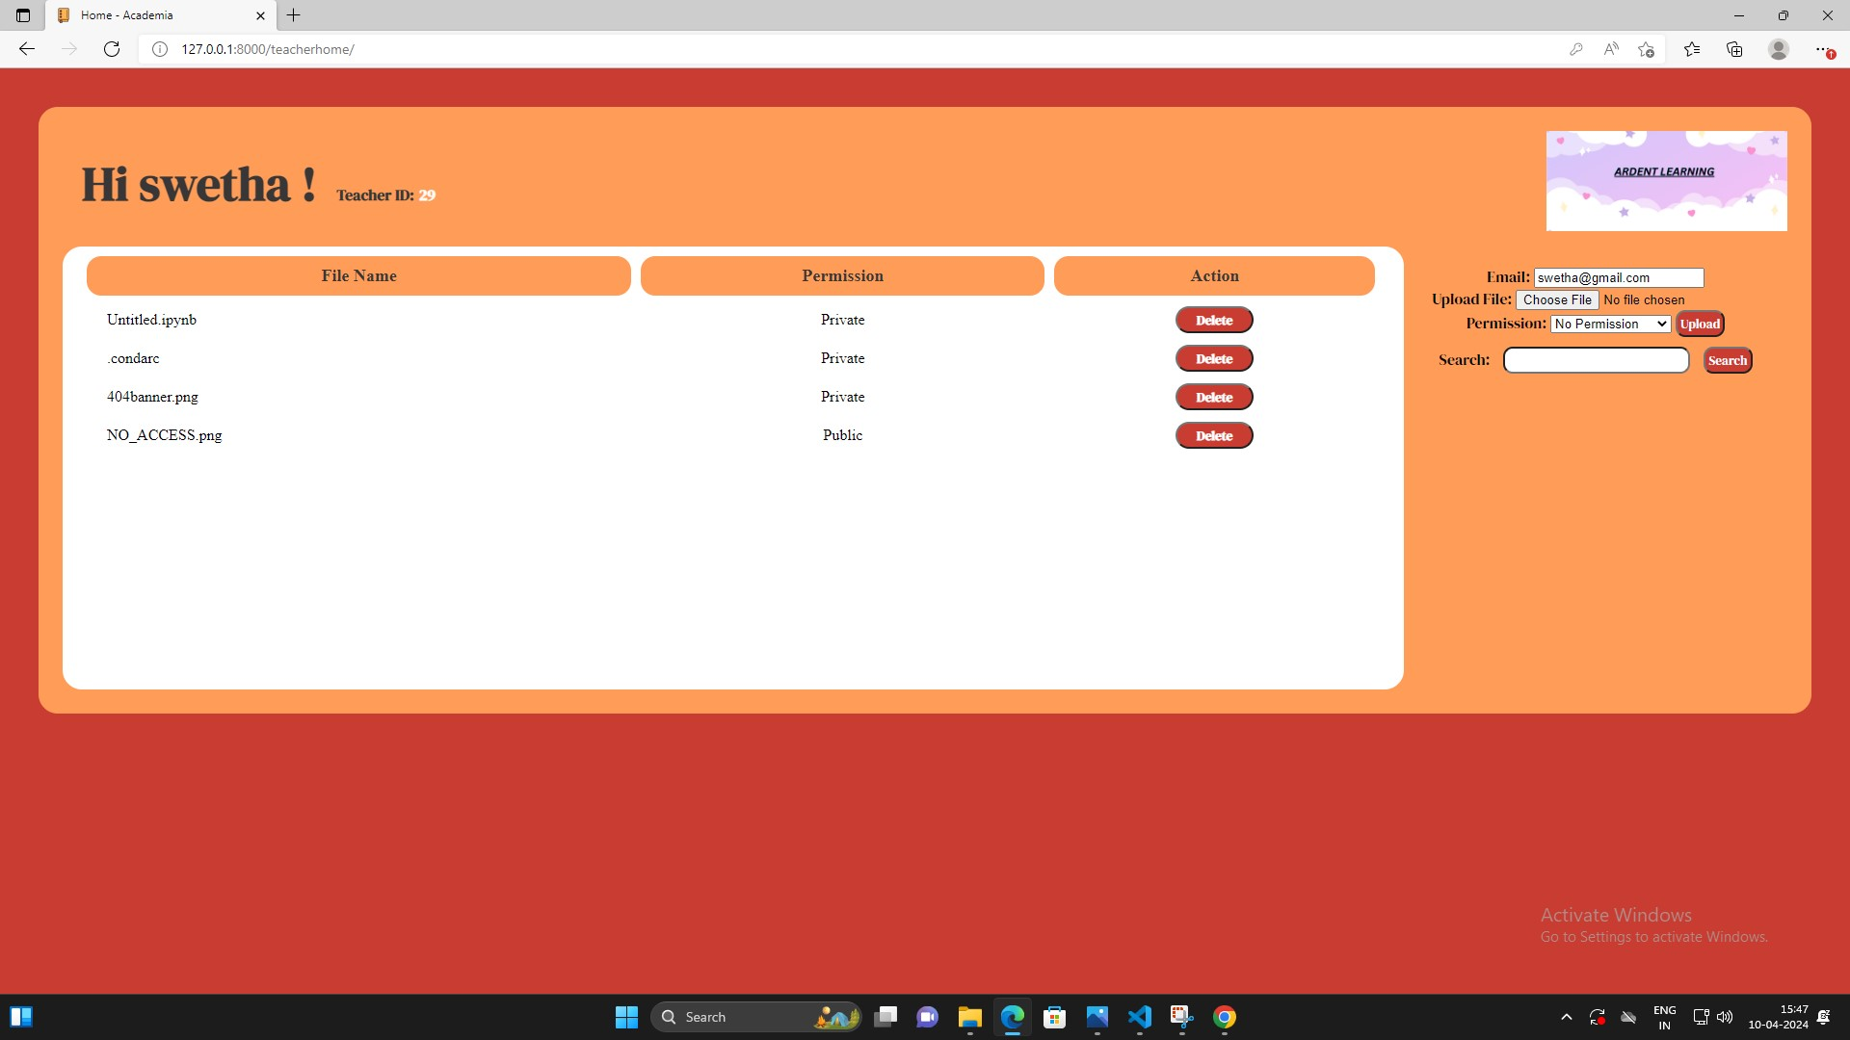
Teachers Login-Page

Slide 13
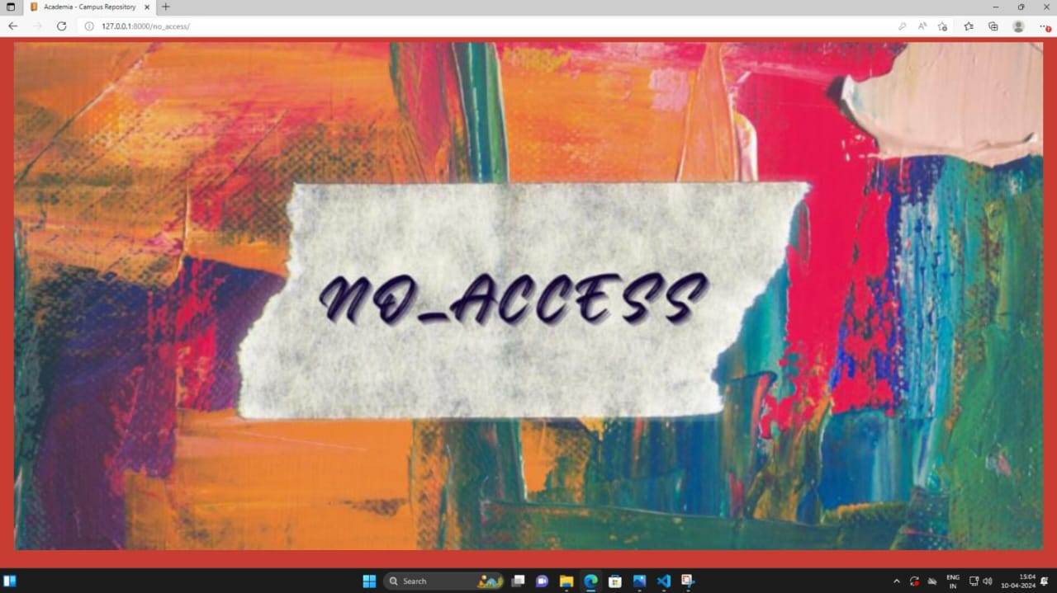
no_access-Page

Slide 14
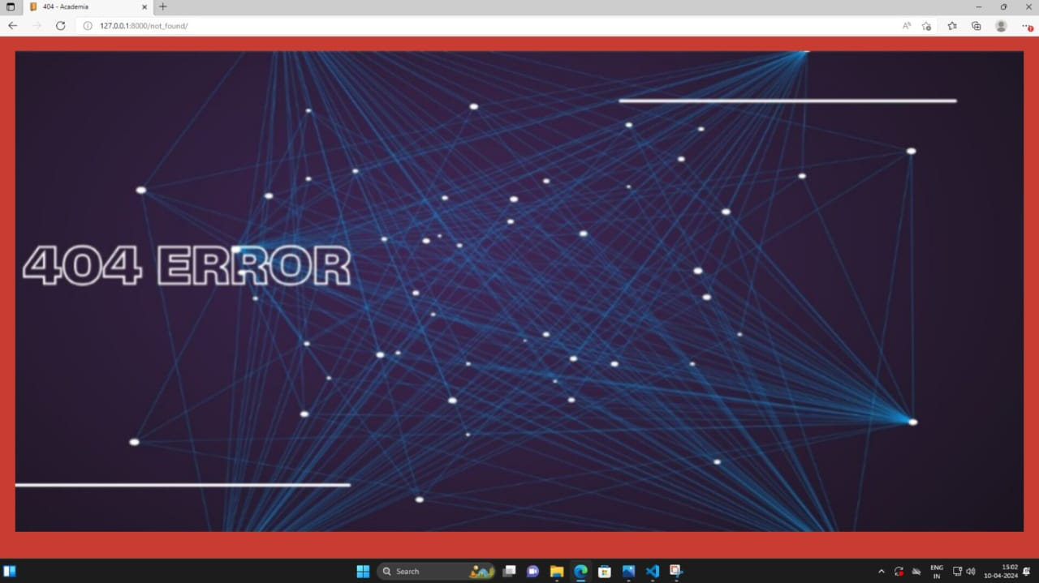
ERROR-Page

Slide 15
Future Enhancements:
Real-time Collaboration is Implemented in real-time editing and collaboration features using Web Sockets or similar technologies to allow multiple users to work on the same node simultaneously.
Enhanced Search and Navigation is Improved and search functionality and navigation within the node-sharing platform to help users easily find and access relevant content.
Version Control is Introduced for version control features to track changes made to nodes, allowing users to revert to previous versions if needed.
Mobile App Integration is a development of a mobile app that syncs with the web application, allowing users to access and edit nodes on the go.
Integration with Learning Management Systems (LMS) Integrate the node-sharing platform with popular LMSs to streamline the sharing and management of educational content.
Advanced Analytics provides insights into user activity and node usage to help users and administrators understand how content is being used and identify areas for improvement.
Gamification add elements such as badges, leaderboards, or rewards to incentivize user engagement and contribution.
Accessibility Features ensure that the web application is accessible to users with disabilities, following WCAG guidelines and Enhanced Security Implement additional security measures, such as two-factor authentication and data encryption, to protect user data Integration with Other Tools: Integrate with other productivity tools such as calendars, task managers, or communication platforms.

Slide 16
Conclusion
The note-sharing web application provides a versatile platform for users to collaborate, organize, and share their notes effortlessly. With its intuitive interface and robust features, it fosters seamless communication and knowledge exchange among individuals and groups. Whether for educational purposes, professional projects, or personal endeavors, this application streamlines the process of creating, editing, and distributing notes, ultimately enhancing productivity and facilitating meaningful collaboration
In conclusion, the note-sharing web application serves as a vital tool for modern-day knowledge management and collaboration. Its user-friendly design and comprehensive features empower individuals and teams to efficiently create, share, and organize notes, fostering collaboration and driving productivity.
By facilitating seamless communication and information exchange, the application enables users to harness the collective intelligence of their peers and achieve greater success in their endeavors. Whether for educational, professional, or personal use, this platform revolutionizes the way people collaborate and learn in the digital age.
Source :

Slide 17
Thank You!
Notes:
Thank You !!

